Slide 1
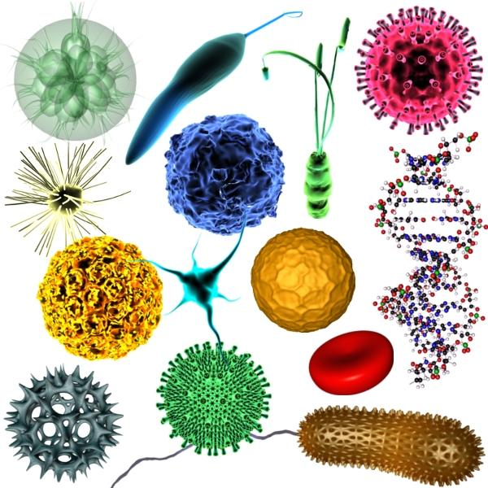
An Easy Approach To Medical Microbiology
Dr. Ajab Khan Yousafzai
(Pharm.D)
University Of Peshawar

Slide 2
UNIT # I
INTRODUCTION TO MICROBIOLOGY

Slide 3
Why Study Microbiology?
Impact on Human Health
2. Balance of Nature - food source, play a role in decomposition, help other animals digest grass (cattle, sheep, termites).
3. Environmental – provide safe drinking water; development of biodegradable products; use bacteria to clean up oil spills, etc. – called bioremediation.
4. Industrial – foodstuffs (beer, wine, cheese, bread), antibiotics, insulin, genetic engineering
5. Agricultural - research has led to healthier livestock and disease-free crops.

Slide 4
Microbiology
The study of microbiology is the study of microorganisms, which are organisms that are invisible to the naked eye.

Slide 5
2 types of cells
1. Prokaryotic ("before nucleus") – these are cells, but they have no internal membrane bound structures (no membrane-bound nucleus or membrane-bound organelles); includes only the bacteria.
2. Eukaryotic ("true nucleus") – do have internal membrane bound structures (membrane bound nucleus and membrane-bound organelles); includes organisms such as protozoans, fungi, algae, animals, plants.

Slide 6
Classification of Microorganisms
The 5 major groups of microorganisms:
bacteria,
algae,
fungi,
protozoa,
Viruses
&……?

Slide 7
Bacteria
(singular - bacterium) (study of bacteria – bacteriology)
1. prokaryotic
2. unicellular
3. size: 1/1000 the volume of a typical eukaryotic cell
4. 2 groups (discovered in 1970's) - we'll discuss more later
a. Archaeobacteria - ancient bacteria
b. Eubacteria - true bacteria
5. some shapes: bacillus (rod), coccus (spherical), spirillum (spiral), vibrio (curved rod)
6. motile or nonmotile

Slide 8
Bacteria
7. how do they obtain their energy?
a. photosynthetic autotrophs - use energy from the sun to produce their own carbohydrates for energy.
b. chemosynthetic autotrophs - process inorganic molecules for energy (ex. sulfur or iron).
c. heterotrophs - depend on outside sources of organic molecules (ex. carbohydrates or sugars) for energy
8. temperature extremes: -20ºC to 110ºC (that’s really cold & really hot! freezing is OºC and boiling is 100ºC)

Slide 9
examples of diseases?

Slide 10
Algae
(singular - alga) - not a focus in this course.
1. eukaryotic
2. unicellular or multicellular
3. size: some microscopic, some macroscopic (ex. kelp)
4. motile or nonmotile
5. how do they obtain their energy? photosynthetic autotrophs
6. disease causing?

Slide 11
no

Slide 12
Fungi
singular - fungus (study of fungi – mycology)
1. eukaryotic
2. unicellular or multicellular (yeasts are unicellular, molds are multicellular)
3. nonmotile
4. how do they obtain their energy?
a. heterotrophs
b. Why are they ecologically important? Scavengers; they live off dead matter and thus, decompose it.
5. examples of diseases (called mycosis)?

Slide 13
Protozoa
("first animals")
1. eukaryotic
2. unicellular
3. motile or nonmotile
4. how do they obtain their energy?
Heterotrophs
5. disease causing – 2 examples: malaria & giardiasis (one of the “don’t drink the water diseases”)

Slide 14
Viruses
(study of viruses – virology)
1. acellular, so not considered prokaryotic or eukaryotic; obligate intracellular parasites; when they are outside of a host cell, there is no evidence that these guys are alive.
2. basic structure of a virus - a piece of nucleic acid (RNA or DNA) enclosed by a protein coat (capsid); possess no nucleus, organelles, cell membrane, or cytoplasm.
3. size - 1/10 to 1/1000 the size of an ordinary bacterial cell.
4. nonmotile
5. examples of diseases?

Slide 15
Poliomyelitis

Slide 16
Important Note
We will consider a sixth group, the helminths (worms), in our study of microbiology. While most of the adult stages of these worms are macroscopic, many of them go through a microscopic stage in their life cycles (egg & larval stages). Some examples of helminths are tapeworms, hookworms, pinworms, heartworms, and Chinese liver flukes. More to come later!!

Slide 17
A Brief History of Microbiology

Slide 18
Leeuwenhoeck (lived 1632-1723)
First person to use microscopes to observe microbes; as a hobby he made small handheld microscopes; he called microorganisms “animalcules.”

Slide 19
Hooke
He first described “cellulae” (small rooms) in cork in 1665. His discovery led to the formulation of the cell theory, which states that cells are the basic organizational unit of all living things.

Slide 20
late 1600’s Francisco Redi,s exp
Living organisms arise from nonliving things (ex. maggots come from rotting meat)
In the late 1600’s Francisco Redi showed that maggots developed only in meat that flies could reach to lay eggs on.
Many insisted that he only disproved spontaneous generation for macroorganisms; maybe microbes were an exception.

Slide 21
Spallanzani
Spallanzani put broth in a flask, sealed it (creating a vacuum), & then boiled it. There were no microbes in the cooled broth! Critics said he didn't disprove spontaneous generation - they said he just proved that spontaneous generation required air.

Slide 22
Pasteur's Experiments (1859)
To offset the argument that air was necessary for spontaneous generation, Pasteur allowed the free passage of air, but prevented the entry of microbes. He boiled meat broth in a flask
No microbes developed in the flask.
Pasteur's success was partly due to good luck.He used meat, which contains few bacterial endospores (endospores are resistant to heat; many experiments done prior to Pasteur's used vegetable broths - plants contains many endospore-forming bacteria.)

Slide 23
3 things did Pasteur's experiments proved
a. No living things arise by spontaneous generation.
b. Microbes are everywhere - even in the air and dust
c. The growth of microbes causes dead plant & animal tissue to decompose & food to spoil (this led him to develop the technique of pasteurization - he developed it to keep wine from spoiling).

Slide 24
(Pasteurisation)
Pasteurization
partial sterilization of foods at a temperature that destroys harmful microorganisms without major changes in the chemistry of the food

Slide 25
GENERAL SAFETY PRINCIPLES
The following guidelines have been established to assist lab faculty and staff to manage potential hazards and to maintain a basic level of safety. Shown below are guidelines that establish minimum requirements for those who may use and/or work in labs

Slide 26
Carefully read labels before using an unfamiliar chemical
Determine the potential hazards and use appropriate safety precautions before beginning any new operation.
Be familiar with the location of emergency equipment such as fire alarms, fire extinguishers, emergency eyewash, and shower stations and know the appropriate emergency response procedures.

Slide 27
. Avoid distracting or startling other workers when they are handling hazardous materials.
Always be alert to unsafe conditions and actions and call attention to them so that corrective action can be taken as quickly as possible
Wear appropriate skin, eye and face protection.

Slide 28
HEALTH AND HYGIENE
Avoid tasting or smelling chemicals.
Avoid direct contact with any hazardous material.
Confine long hair and loose clothing and always wear footwear that fully covers the feet.
Do not mouth-pipette.
Wash thoroughly with soap and water after handling chemicals or biological materials, before leaving the laboratory and before eating or drinking.

Slide 29
FOOD AND DRINK IN THE LABORATORY
Avoid eating, drinking, smoking.
Refrigerators and microwave ovens used for chemical or biological storage or other laboratory use shall not be used for food storage or preparation

Slide 30
HOUSEKEEPING
Keep work areas (including floors) clean and uncluttered.
Clean up work areas after the work is finished or at the end of each lab or workday
Dispose of waste.
Clean spills immediately and thoroughly.
Do not block exits, emergency equipment or controls. Do not use hallways and stairwells for storage

Slide 31
HAZARDOUS MATERIALS HANDLING AND STORAGE
Chemical containers with missing or defaced labels should not be accepted.
Chemicals shall be segregated by compatibility.
Storage of hazardous materials at the lab bench or work area shall be kept to a minimum.
A Hazardous material mixture shall be assumed to be as toxic as its most toxic component.
Substances of unknown toxicity shall be assumed to be toxic.
A warning notice must be posted near the experiment if hazardous conditions are present

Slide 32
WORKING ALONE
In no case is working alone permitted during procedures involving highly hazardous or toxic chemicals or agents and/or dangerous equipment or environments (i.e.: anything that could cause severe injury or death).

Slide 33
VOLUNTEERS IN THE LAB
Any volunteer conducting lab work must be provided with written instructions to complete safety training prior to working in the lab.
No one under the age of 16 may work or volunteer in a lab.

Slide 34
GENERAL PROPERTIES OF VIRUSES
Viruses contain either DNA or RNA as their genetic material, but not both. This nucleic acid usually has unique chemical and/or physical features which makes it distinguishable from human nucleic acid
Viral nucleic acid is enclosed in a capsid made up of protein subunits called protomeres.
Some species of viruses have a membrane, the envelope, surrounding the capsid; other species do not have an envelope, i.e., they are naked.
Enveloped viruses have glyco-protein spikes arising from their envelope.
These spikes have enzymatic, absorptive, hemagglutinating and/or antigenic activity.

Slide 35
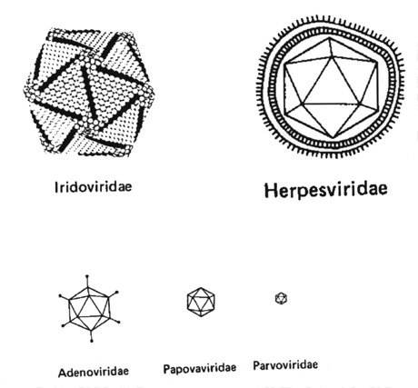
Shapes of viruses
The morphology of a virus is determined by the arrangement of the protomeres.

Slide 36
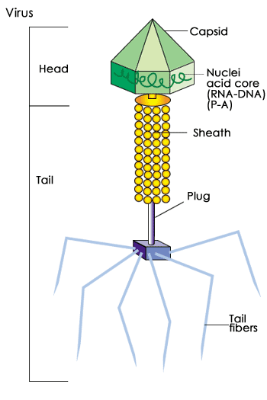

Slide 37
Properties
All viruses undergo a replication cycle in their human host cell consisting of adsorption, penetration, uncoating, nucleic acid replication, maturation and release stages.
During the viral replication cycle, an accumulation of mature viruses, incomplete viruses and viral parts occurs within the cell.
The size, shape, location and chemical properties of the inclusion body are used by the pathologist to diagnose viral infectious disease.

Slide 38
Properties
In general, all DNA-containing viruses replicate in the host cell nucleus. The exceptions to the rule are the poxviruses.
In general, all RNA-containing viruses replicate in the host cell cytoplasm. The exceptions to the rule are the retroviruses (any of a group of viruses that contain two single-strand linear RNA molecules) and the orthomyxoviruses*.
(*GROUP OF INFLUENZA VIRUSES)

Slide 39
Need of microbiology to a nurse
A nurse needs to know:
What are effective ways of preventing infections?
What the signs of infections are (eg. What are the signs of bacterial infections?)
How normal flora contribute to health?

Slide 40
Need of microbiology to a nurse
make an idea about spreading of infection.
know about the surfaces which are susceptible to infectious agent.
keep instruments aseptic.
recoganise symptoms of an infection.
to take care of an open wound.
recoganise the type of infection at its early stage.

Slide 41
TYPES OF BACTERIA ON NUTRITION BASES……!

Slide 42
Autotrophic Bacteria
These are bacteria which are able to synthesize their own organic food from inorganic substances.
They use carbon dioxide for obtaining carbon and utilise hydrogen sulphide (H₂S) or ammonia (NH₃) or hydrogen (H₂) as the source of hydrogen to reduce carbon.
These bacteria can be distinguished further into two types as follows:

Slide 43
Photoautotrophic Bacteria
The photoautotrophic bacteria possess photosynthetic pigments with in their cells and utilize solar energy.
The bacterial photosynthesis is different from that of green plants since here water is not used as a hydrogen donor.
Hence oxygen is not released as a byproduct. For this reason, the process is described as anoxygenic photosynthesis.

Slide 44
Chemosynthetic Bacteria
These are bacteria which manufacture organic compounds from inorganic raw materials utilizing energy liberated from the oxidation of inorganic substances. Following are the common types of chemo autotrophic bacteria.
1. Nitrifying bacteria which derive energy by oxidizing ammonia into nitrates. Eg: Nitrosomonas, Nitrobacter.
2. Sulphur bacteria which derive energy by oxidising hydrogen sulphide to sulphur. Eg: Thiobacillus, Beggiatoa.
3. Iron Bacteria which derive energy by oxidizing ferrous ions into ferric form. Eg: Ferrobacillus, Gallionella.

Slide 45
Heterotrophic Bacteria
These are bacteria which are unable to manufacture their own organic food and hence are dependent on external source. These bacteria can be distinguished into three groups as follows

Slide 46
Saprophytic Bacteria
These bacteria obtain their nutritional requirements from dead organic matter.
They breakdown the complex organic matter into simple soluble form by secreting exogenous enzymes.

Slide 47
Symbiotic Bacteria
These are bacteria which live in a mutually beneficial association with other organisms. Such bacteria derive the essential nutrients from their host organisms and in that process help the host through some of their biological activities.
The most familiar example of symbiotic bacteria are the nitrogen fixing bacteria found in the root nodules of leguminous (pod) plants. Bacteria such as Rhizobium and Pseudomonas reside in the root nodules and reduce atmospheric nitrogen directly to ammonia. This becomes the source of nitrogen for the host plants. The plants in return provide bacteria with nutrients and protection.

Slide 48
E.Coli in Human
The bacteria found in the human alimentary canal Escherichia coli are nonpathogenic. These bacteria check the growth of harmful putrefying bacteria. In addition, these bacteria release vitamins K and B12 which are necessary for blood components. The human host provides shelter and food for these bacteria.

Slide 49
Parasitic Bacteria
These are bacteria which occur in the body of animals and plants, obtaining their organic food from there.
Most of these bacteria are pathogenic, causing serious diseases in the host organisms either by exploiting them or by releasing poisonous secretions called toxins.

Slide 50
Shape of Bacteria
Cocci – spherical/ oval shaped major groups
Bacilli – rod shaped
Vibrios – comma shaped
Spirilla – rigid spiral forms
Spirochetes – flexible spiral forms
Actinomycetes – branching filamentous bacteria
Mycoplasmas – lack cell wall

Slide 51
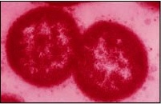



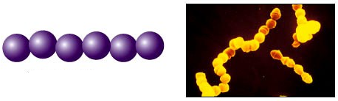
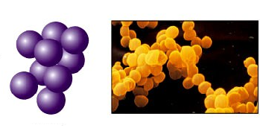
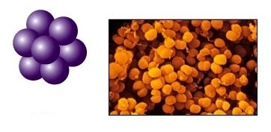
Arrangement of bacteria: Cocci
Coccus
Cocci in pair – Diplococcus
Tetrad – groups of four
Cocci in chain - Streptococci
Cocci in cluster - Staphylococci
Sarcina – groups of eight

Slide 52
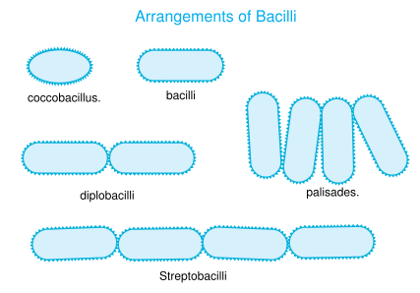
Arrangement of bacteria: Bacilli

Slide 53
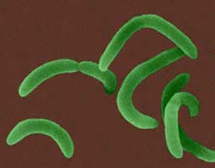
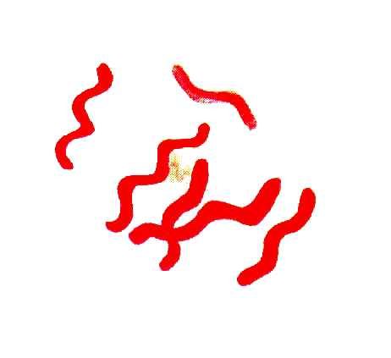
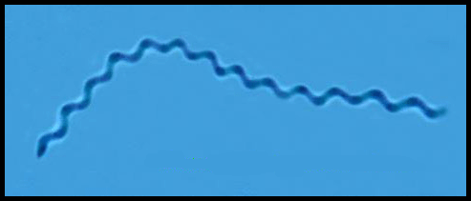
Other shapes of bacteria
Comma shaped
Spirilla
Spirochets

Slide 54
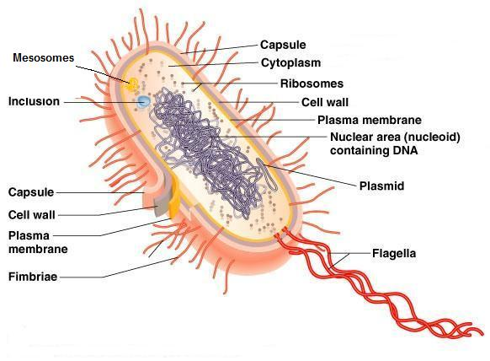
Anatomy of a Bacterial Cell

Slide 55
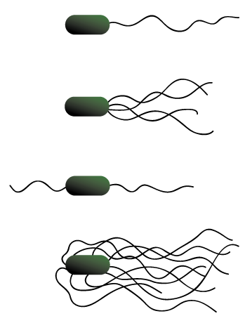

Polar/ Monotrichous – single flagellum at one pole
Lophotrious – tuft of flagella at one pole
Amphitrichous – flagella at both poles
Peritrichous – flagella all over
Amphilophotrichous – tuft of flagella at both ends

Slide 56
Pleomorphism & Involution forms
Pleomorphism – great variation in shape & size of individual cells e.g. Proteus species
Involution forms – swollen & aberrant forms in ageing cultures, especially in the presence of high salt concentration e.g. plague bacillus
Cause – defective cell wall synthesis

Slide 57
Nomenclature
Two kinds of name are given to bacteria
  Casual / common name – for local use, varies from country to country
  e.g. “typhoid bacillus”
  Scientific / International Name – same all over world, consists of two words (in Italics)
  e.g. Salmonella typhi

Slide 58
How to use a microscope
1. When moving your microscope, always carry it with both hands (Figure 1, below). Grasp the arm with one hand and place the other hand under the base for support.
2. Turn the revolving nosepiece so that the lowest power objective lens is "clicked" into position (This is also the shortest objective lens).

Slide 59
How to use a microscope
3. Your microscope slide should be prepared with a coverslip or cover glass over the specimen. This will help protect the objective lenses if they touch the slide. Place the microscope slide on the stage and fasten it with the stage clips. You can push down on the back end of the stage clip to open it.

Slide 60
How to use a microscope
4. Look at the objective lens and the stage from the side (Figure 2) and turn the coarse focus knob so that the objective lens moves downward (or the stage, if it moves, goes upward). Move it as far as it will go without touching the slide!
5. Now, look through the eyepiece and adjust the illuminator (or mirror) and diaphragm (Figure 3) for the greatest amount of light.

Slide 61
How to use a microscope
6. Slowly turn the coarse adjustment so that the objective lens goes up (away from the slide). Continue until the image comes into focus. Use the fine adjustment, if available, for fine focusing. If you have a microscope with a moving stage, then turn the coarse knob so the stage moves downward or away from the objective lens.

Slide 62
How to use a microscope
7. Move the microscope slide around so that the image is in the center of the field of view and readjust the mirror, illuminator or diaphragm for the clearest image.
8. Now, you should be able to change to the next objective lenses with only minimal use of the focusing adjustment. Use the fine adjustment, if available. If you cannot focus on your specimen, repeat steps 4 through 7 with the higher power objective lens in place. Do not allow the objective lens to touch the slide!

Slide 63
How to use a microscope
9. The proper way to use a monocular microscope is to look through the eyepiece with one eye and keep the other eye open (this helps avoid eye strain). If you have to close one eye when looking into the microscope, it's ok. Remember, everything is upside down and backwards. When you move the slide to the right, the image goes to the left!

Slide 64
How to use a microscope
10. Do not touch the glass part of the lenses with your fingers. Use only special lens paper to clean the lenses.
11. When finished, raise the tube (or lower the stage), click the low power lens into position and remove the slide.
12. Always keep your microscope covered when not in use.

Slide 65
1. Immunity
Stimulating the body's own ability to combat infection; from ancient times it was a recognized fact that people who suffered from certain diseases never got them again; infection could produce immunity.
Immunization; to produce immunity by providing exposure to altered organisms that do not cause disease.

Slide 66
2. Public Hygiene
Improving sewage disposal.
Assuring a clean public water supply.
Food preservation & inspection.
Eg. Pasteurization - kills most microbes by exposing to heat.

Slide 67
3. Chemotherapy
The father of chemotherapy.
Paul Ehrlich discovered a drug treatment for syphilis; he developed the guiding principle of chemotherapy, which has selective toxicity.
The drug must be toxic to the infecting microbe, but relatively harmless to the host’s cells.

Slide 68
Microbial Nutrition
- Nutrients: are substances that are used to supply energy.
- Nutrients are substances used in biosynthesis and energy production
and requires for growth. Nutrients are basically classified into two types.
• Macronutrients:
These are Required by microorganisms in large amounts and constitute
95% of cell dry weight.
-Basic Microbial Nutrients:
-H2O, C, O, H, N, S, P

Slide 69
• Water
Water is essential for cellular activities. It constitutes 70-
90% of the weight of a cell. Water is a universal solvent
and it dissolves many chemical substances including
nutrients to make them readily available for the absorption
by microorganisms.
▪ Carbon
Microorganisms use carbon as an essential nutrient. It
constitutes about 50% of the dry weight of a bacterial cell.
Two major sources of carbon are organic and inorganic
compounds.
Carbon dioxide is inorganic source of carbon.

Slide 70
• Oxygen:
Oxygen is very important for life but, however, there are
some exceptions for some bacteria.
The bacteria which can live only in the presence of
molecular oxygen are called strict aerobes (e.g,
Mycobacterium tuberculosis) and those which can grow
only in the absence of oxygen are called strict anaerobes
(e.g, Clostridium tetani)
Some of the bacteria that can live in both conditions are
called facultative anaerobes.
Eg. E.coli

Slide 71
• Nitrogen
Nitrogen is a major constituent of protein, nucleic
acid, and other molecules of microorganisms. It is,
therefore, very important.
A typical bacterial cell is composed of 12% of
nitrogen by its dry weight.
Microorganisms obtain nitrogen from organic and
inorganic sources. Organic sources include amino
acids and other organic nitrogen containing
compound.
Inorganic sources include atmospheric nitrogen,
nitrate and ammonia etc.

Slide 72
• Sulfur
Sulfur is an essential constituent of proteins. It is
primarily found in sulfur-containing amino acids
like cysteine and methionine. Some bacteria use H2S
and sulfides as a source of sulfur.
Phosphorous
Phosphorous is an important component of bacterial
cell. It is a constituent of nucleic acid,
phospholipids, nucleotides, and ATP etc.
The common sources of phosphorous for bacteria are
phosphate salts.

Slide 73
Micronutrients
micronutrients or trace elements are required in trace
amounts by most cells.
The common micronutrients are Na, Mg, Cl, K, Ca,
Mn, Fe, Zn, Co, etc.
They are part of enzymes and cofactors. All these
micronutrients are obtained by microorganisms from
their environment. Some of the bacteria cannot live
in the absence of specific micronutrients which are
called fastidious organisms.
E.g Neisseria gonorrhoeae

Slide 74
UNIT # II
CONTROL OF MICROORGANISMS

Slide 75
Microbial Growth Control
Microbial Growth Control
MGC is very important for us in many ways……?
There are various methods to control the growth of bacteria, e.g., on food to prevent spoilage.
Begin with physical methods to control growth and then look at chemical methods.

Slide 76
Heat Sterilization
Two important parameters: How long? and What temperature? Both of these can vary depending on the sensitivity of the microorganisms to temperature. Temperature effects are obvious when you look at what is called decimal reduction time - which is the time required to reduce the population by 10 fold at a given temperature.
Thermal Death time - is the time required to kill all bacteria in a sample at a specific temperature.
Thermal death point is the lowest temperature at which all microbes in a liquid will be killed in 10 minutes.

Slide 77
Heat killing is most effective if the heat is a moist heat. Dry heat killing requires higher temperatures for longer periods of time.
Heating must kill spores which are heat resistant structures. The environment the spores are in, affects their sensitivity to heat killing. For example a solution rich in sugars and proteins increases spores resistance to heat killing. Also the amount of water in the spores affects their sensitivity - the more water the more sensitive.

Slide 78
Electromagnetic radiations
microwave, UV, X-rays, and gamma rays are all forms of electromagnetic radiation. They all work in different ways, for example microwaves heat up the sample, UV breaks the DNA up causing death.
Ionizing radiation - electromagnetic radiation that produces electrons, hydroxyl radicals, and hydride radicals. These products react with macromolecules such as DNA and proteins which are detrimental to the cell. Common sources of ionizing radiation are ⁶⁰Co and ¹³⁷Cs. Radiation is becoming accepted for foods.

Slide 79
Non-ionizing radiation - Longer wavelength than ionizing radiation, therefore less energetic. Ultraviolet light is the best example of non-ionizing radiation. Ultra violet light inhibit correct DNA replication. Best wavelength is about 260 nm. Used to sterilize open surfaces like in hospital rooms or operating rooms. Organism must be directly exposed to UV for it to kill. Sunlight has UV wavelength but the shorter wavelengths are absorbed by the ozone layer of the atmosphere.

Slide 80
Filtration
Filter sterilization - useful for sterilizing heat labile liquids. The filters have pores of specific sizes down to 0.01 micron in diameter.
Three types of filters
Depth filters - routine filters made of paper, asbestos or glass fibers. Just a mat of the fibers.
Membrane filters - cellulose acetate or cellulose nitrate materials. Contains lots of tiny holes that act live sieves to retain bacteria.
Nucleopore filters - polycarbonate filters. Very uniform pore sizes. Great for microscopy work since the filters are flat in nature.

Slide 81
The autoclave -
15 lbs/sq. inch which yields a temperature of 121 °C for 10 -15 minutes.
Pressure = 15 lbs/sq.inch
Temprature = 121°C
Time = 10-15 minutes

Slide 82
Pasteurization
Classic pasteurization treatment is 63 °C for 30 minutes.
Not all materials can withstand autoclaving, e.g., milk, so they are pasteurized. Pasteurization is a mild heating to kill sensitive spoilage bacteria.
Milk is heated to 71-72 °C for 15 seconds in a continuous flow system in what is called High temperature short-time pasteurization (HTST).
Ultra high temperature treatments - pasteurization treatment that allows milk to be stored at room temperature for a period of time. Treatment is 140 °C for less than a second.

Slide 83
Low temperature treatment
Low temperatures of the refrigerators (0-7°C) inhibits toxin production but does not kill microbes
It is bacteriostatic. microbes will grow slowly on refrigerated foods and cause change off flavors and colors.

Slide 84
Antiseptics and disinfectants
Antiseptics are chemicals sufficiently non-toxic to use on living tissue. Includes silver nitrate, iodine, alcohol (70%), and hydrogen peroxide.
Disinfectants are chemicals that kill microorganisms and are used on inanimate objects.

Slide 85
Chemical Agents
chemical agents that either kill or inhibit growth.
Bacteriocidal agents kill bacteria and bacteriostatic agents inhibit growth.Bacteriostatic agents usually target a cellular process such as protein synthesis where they inhibit ribosomes
Bacteriocidal agents kill cells but do not cause lysis of cells. These agents bind tightly to their target.
Bacteriolytic agents kill cells by lysis.
Minimal inhibitory concentration (MIC)- concentration of chemical agent that inhibits growth of microbes.

Slide 86
Phenol and derivatives (phenolics)
Mode of action: injures plasma membrane, denatures proteins and inactivates enzymes
Cresols found in Lysol
Halogens (e.g., iodine and chlorine)
Mode of action: Iodine binds to tyrosine residue of proteins and causes inhibition. Iodine oxidizes sulfhydryl groups and disrupts the structure of proteins.
Chlorine and water forms hypochlorous acid (HOCl) which is a strong oxidizing agent. Chlorox has NaOCl, the bleaching agent. Can be used to disinfect water at 2 drops per liter of water and let set for 30 minutes.
Alcohol
mode of action: protein denaturation or disrupt the membrane.
Either ethanol or isopropanol are used at concentrations between 95 and 60%; most effective at 70%. There needs to be water around to facilitate the denaturation process.

Slide 87
Heavy metals (e.g., silver, mercury, and copper)
Mode of action: metal ions bind to sulfhydryl groups on proteins and cause the protein to be denatured.
Silver nitrate used to be used to treat the eyes of new born infants for the possible infections.
mercuric chloride has been used as a disinfectant, but less so today. It is very toxic and corrosive.
copper sulfate used to kill algae and prevent mildew when added to paint.
Quaternary ammonium compounds
Mode of action: probably disrupts the membrane although not for sure.
Cepacol - a mouth wash - contains cetylpyridinium chloride
they are ineffective against some species of Pseudomonas since these species will grow on these compounds as a carbon and energy source.
Aldehydes (e.g., gluteraldehyde and formaldehyde)
mode of action: inactivate proteins by forming crosslinks between functional groups of amino acids.

Slide 88
How to find blood groups
Materials Required:
Monoclonal Antibodies ( Anti-A, B and D)
Blood Lancet
Alcohol swabs
Tooth picks
Sterile cotton balls
Clean glass slide
Ice tray
Biohazard disposal container

Slide 89
Procedure:
Set the table with all the materials required. Remember to place the Monoclonal Antibody (Mab) kit in an Ice tray.
Open an Alcohol swab, and rub it at the area from where the blood will be sampled (finger tip). (Discard the swab)
Open the Lancet cover, put pressure at the tip of the finger from where blood will be sampled (maintain it). Prick the finger tip with the opened Lancet.(Discard the Lancet)
As blood starts oozing out, make 1 drop fall on the three depressions of the glass slide. (in clinical setup, there will be a fourth well used as a control).
Place a cotton ball at the site where it was pricked. Using the thumb, put pressure on the area to stop blood flow.
Take the Anti-A (blue) bottle, resuspend the content and use the dropper to place a drop of the Mab in the 1st spot. Place the bottle back in ice.
Take the Anti-B (yellow) bottle, resuspend the content and use the dropper to place a drop of the Mab in the 2nd spot. Place the bottle back in ice.
Take the Anti-D (colorless) bottle, resuspend the content and use the dropper to place a drop of the Mab in the 3rd spot. Place the bottle back in ice.
Take a tooth pick and mix the content in each well. Discard the tooth pick after using in one well (take a new one for the next well).
After mixing, wait for a while to observe the result.

Slide 90
UNIT # III
DEFENCE MECHANISM OF THE BODY

Slide 91
What is antimicrobial resistance?
Antimicrobial resistance (AMR) is resistance of a microorganism to an antimicrobial medicine to which it was originally sensitive. Resistant organisms (they include bacteria, fungi, viruses and some parasites) are able to withstand attack by antimicrobial medicines, such as antibiotics, antifungals, antivirals, and antimalarials, so that standard treatments become ineffective and infections persist increasing risk of spread to others. The evolution of resistant strains is a natural phenomenon. The misuse of antimicrobial medicines accelerates this natural phenomenon. Poor infection control practices encourages the spread of AMR.

Slide 92
Resistance increase if?
Anti microbial drug is used in sub therapeutic dose
Improper indication
Duration of therapy is less than the standard therapy

Slide 93
Sensitivity /Susceptiblity
Antibiotic sensitivity is the susceptibility of bacteria to antibiotics
'The "susceptible" category implies that isolates are inhibited by the usually achievable concentrations of antimicrobial agent when the recommended dosage is used for the site of infection.

Slide 94
Phagocytosis
Phagocytosis (from Greek phagein) , means "to eat up (cyto) , means "cell", and -osis, means "process") is the process by which a cell engulfs a solid particle to form an internal vesicle known as a phagosome.
Phagocytosis is a specific form of endocytosis involving the vesicular internalization of solids such as bacteria, and is therefore distinct from other forms of endocytosis such as the vesicular internalization of various liquids (pinocytosis).
In the immune system, phagocytosis is a major mechanism used to remove pathogens and cell debris. For example, when a macrophage ingests a pathogenic microorganism, the pathogen becomes trapped in a phagosome which then fuses with a lysosome to form a phagolysosome. Within the phagolysosome, enzymes and toxic peroxides digest the pathogen.

Slide 95
Antibody
Antibody (Ab), also known as an immunoglobulin (Ig), is a large Y-shape protein produced by plasma cells that is used by the immune system to identify and neutralize foreign objects such as bacteria and viruses. The antibody recognizes a unique part of the foreign target, called an antigen.Each tip of the "Y" of an antibody contains a paratope (a structure analogous to a lock) that is specific for one particular epitope(similarly analogous to a key) on an antigen, allowing these two structures to bind together with precision. Using this binding mechanism, an antibody can tag a microbe or an infected cell for attack by other parts of the immune system, or can neutralize its target directly (for example, by blocking a part of a microbe that is essential for its invasion and survival). The production of antibodies is the main function of the humoral immune system.

Slide 96
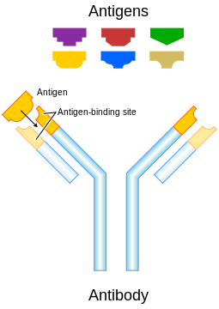
Antigen & Antibody

Slide 97
ANTIBODIES
Antibodies are proteins made up of two light chains and two heavy chains. The heavy chain determines the type of antibody class and is bound to the light chain by sulfhydryl linkages.
Antibodies are composed of a light chain protein and a heavy chain protein that come together and form a Y-shaped structure. The base of the Y is a conserved region that all antibodies have in common, while the tips of the forks of the Y are unique to each antibody. The tips react with the antigen, while the conserved base interacts with the immune system.
Five types of antibodies are formed in the body: IgG, IgM, IgA, IgD and IgE

Slide 98
ANTIBODIES
Antibodies have the interesting challenge of needing to respond to a wide array of antigens, yet still be recognizable to the immune system. They therefore, need to interact with two different types of macromolecules, antigens and parts of the immune system.
The upper variable region react with antigen and the lower constant region interact with the immune system.
Plasma cells synthesize a number of different types of antibodies and these serve different functions for the cell..

Slide 99
Classes Of Antibodies
The general structure of antibodies falls into just five classes and this is based upon the type of heavy chain present in the antibody.
Each antibody binds to a specific antigen; an interaction similar to a lock and key.

Slide 100
Immunoglobulin G
IgG is the most abundant circulating antibody, making up 80% of the total antibodies and 75% of that found in serum. It contains a single antibody protein complex, with two heavy chains and two light chains. IgG is the second type of antibody synthesized in response to an infection and is the only antibody that can pass through the wall of small blood vessels to access antigens present in the extracellular spaces. It is also the only antibody capable of crossing the placenta in humans, where it confers the mother's immunity onto the fetus and newborn. This immunity protects a baby for the first 6-12 months of its life and allows it time for its own immune system to mature. IgG is particularly effective at attacking extracellular viruses and protein toxins. It helps to prevent the systemic spread of infection and facilitates recovery from many infections. Finally, IgG is the antibody that serves as an efficient handle for phagocytes, allowing phagocytes to bind to a pathogen and rapidly phagocytize a pathogen.

Slide 101
Immunoglobulin M
IgM is the largest antibody, with five Y structures being joined by their Fc regions in a circular configuration. A J chain (another polypeptide) links the five antibodies together. IgM is present in serum, making up about 10 % of antibodies in the blood. The presence of its ten antigen reactive sites helps agglutinate or clump antigens (see the explanation of this term in the next section), making it easier for the immune system to eliminate them. IgM is more efficient than IgG at activating the complement pathway. IgM is synthesized by plasma cells early in a primary infection and is very important in slowing or stopping the spread of a pathogen during the initial stages of an illness. IgM is also found on mature B cells in a monovalent form, where it serves as a receptor.

Slide 102
Immunoglobulin A
IgA is present in serum, mucus, saliva, tears, sweat and milk. Two subclasses with different heavy chains are made, IgA1 and IgA2. IgA1 is synthesized in the bone marrow and makes up most of the serum IgA. IgA2 is synthesized by B cells present in MALT( Mucosa-Associated Lymphoid Tissue). The antibodies are synthesized as dimers that are joined by a short J chain polypeptide. As the secreted IgA2 passes through the intestinal epithelium, a second secretory protein attaches. Dimerization and binding of the J and secretory proteins make IgA more resistant to proteases present in the environments that it protects. IgA in breast milk interferes with the colonization of the GI tract by harmful microorganisms in the first few months of life. The mother's IgA in the GI tract of newborns keeps these pathogens at low populations, preventing them from causing serious disease, but still allowing the stimulation of the infant's own immune system. The newborn thus develops its own immunity while being partially protected by the mother. IgA molecules do not activate the classical complement pathway, but may activate the alternative complement pathway.

Slide 103
Immunoglobulin E/D
IgE is a monomeric antibody that accounts for only 0.002 % of the total serum antibodies. Almost all IgE is bound to tissue cells, especially mast cells and eosinophils in various parts of the body. Contact of IgE with antigen leads to release of a set of signal molecules from the mast cells, which effectively recruits various agents of the immune response to fight the infection. IgE and MALT serve to detect penetrating pathogens and amplify the immune response in an area leading to the repulsion of the invader. Antigen reactions with IgE are also responsible for atopic allergic reactions (a hypersensitive state acquired through exposure to a particular allergen, e.g., hives, asthma, hay fever etc.)
IgD is found on the surface of B-lymphocytes and together with monomeric IgM, serves as antigen receptor for the activation of B cell with a concentration in serum far below those of IgG, IgA, and IgM but much higher than that of IgE. IgD is monovalent.

Slide 104
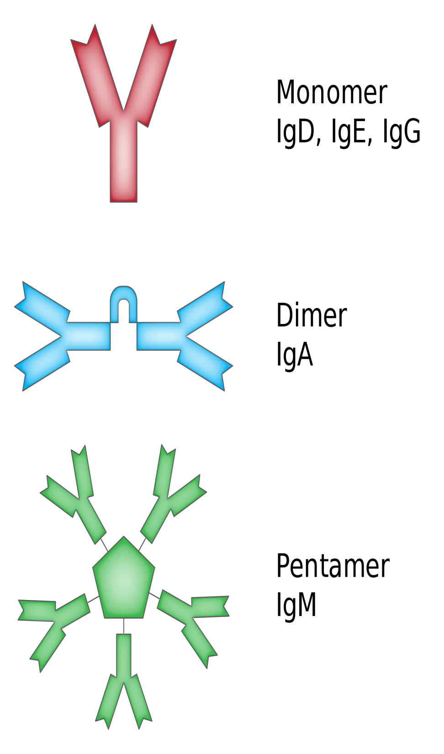
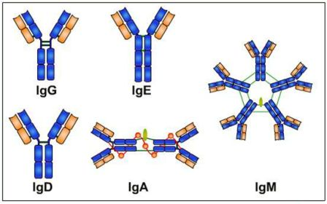

Slide 105
Difference between innate immunity, and acquired immunity
Innate immunity-Non-specific
Inborn
Acquired from mother
Acquired immunity-Specific
Which is acquired after a specific antigen exposure
Eg..exposure to small pox, chiken pox etc

Slide 106
Antigen(Ag)
A substance the body recognizes as FOREIGN and to which it mounts IMMUNE response
-Non-self
-Immunogenic: Stimulates an immune response (immunogen)
-Reactive: reacts w/ immune response
-Large complex molecules

Slide 107
Specific resistance
Also known as (Acquired Immunity).
It is a type of immunity which is very much specific.
Its against a specific type of antigen (foreign object).
AB(antibody) mediated.

Slide 108
Nonspecific resistance( Innate Immunity)
-Physical barriers
-Chemical barriers
-Cellular defenses-phagocytes & phagocytosis
-Inflammation
-Fever

Slide 109
Antibodies
(Ab) are
-Proteins that circulate in the bloodstream
-Immunoglobins
-Synthesized and secreted by plasma cells
-B lymphocytes that circulate in the bloodstream and synthesize & secrete Ab
-Each Ab is specific for a particular antigen
-React w/ Ag ; Ex: toxins, viruses

Slide 110
Primary Ab response
-Occurs first time an Ag is encountered
-Ab begins to appear in ~5days
-First Ab is IgM, then it decreases
-Next Ab is IgG, appears in greater amount

Slide 111
Secondary Ab response
-Occurs at second/subsequent Ag exposure
-Results from B memory cells
-Occurs more quickly than primary response
-Produces more Ab then primary response
-Last longer then primary response

Slide 112
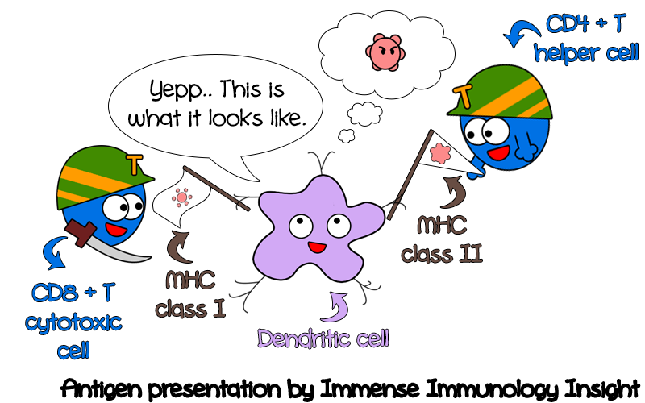

Slide 113
How do antibodies work?
(Opsonize)
enhance phagocytosis
-Ab is an opsonin, a handle for phagocytosis
make (cells) more susceptible to the action of phagocytes
(agglutinate)
Clump particles together, making them easier to phagocytose
united as if by glue
(precipitate)
Clump soluble molecules together, making them easier to phagocytose.
Separate it just like a solid substance in suspension or after settling or filtering
(Activate complement)
Forms MAC(memory attack complex) resulting in Lysis, killing of pathogens

Slide 114
Types of acquired immunity
Passive-Immune response provided to the host.
Eg…breast feeding provides anti bodies
Active-Immune response develops within the host.
Eg…if some antigen comes inside the body, response is developed.
Natural-Immune response develops naturally.
Eg.. Against measles
Artificial-Immune response develops after an intentional or purposeful action.
Eg.. Vaccines

Slide 115
What is natural, active immunity?
Exposure to infectious agent, or occurrence of infection
Clinical or subclinical disease can trigger immune response.
Eg (measles)

Slide 116
What is Artificial, active immunity
Ex: immunization, vaccine in the form of live attenuated or killed agents.

Slide 117
What is natural, passive immunity
Maternal Ab provided to fetus/newborn
Ab crosses the placenta( protects for 3-6 months)
Ab in colostrum & breast milk, protects G.I. tract

Slide 118
What is Artificial, passive Immunity
Administration of preforms Ab to a host
Antiserum, hyperimmune serum, immune globulin, or gamma-globulin
E.g Tetanus immune globulin, Rabies immune globulin.

Slide 119
Hypersensitivity
Hypersensitivity (also called hypersensitivity reaction or intolerance)
It refers to undesirable reactions produced by the normal immune system, including allergies and autoimmunity.
These reactions may be damaging, uncomfortable, or occasionally fatal.
An excessive or abnormal sensitivity to a substance.
A person who is hypersensitive to a certain drug will often suffer a severe allergic reaction if given the drug.

Slide 120
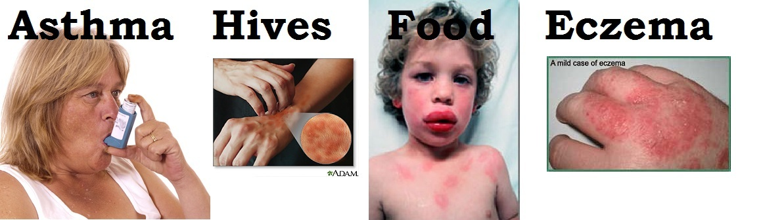
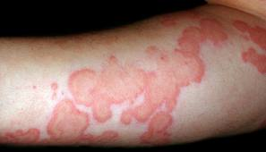

Slide 121
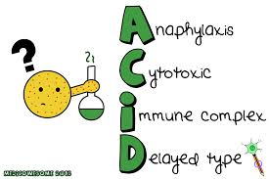
TYPES OF HYPERSENSITIVITY REACTIONS

Slide 122
Immediate (type I) hypersensitivity
Immediate hypersensitivity is a rapid IgE- and mast cell-mediated vascular and smooth muscle response that occurs in genetically susceptible individuals upon exposure to certain environmental antigens to which they have been previously exposed.
These reactions are also known as allergies, and the antigens that instigate these reactions are commonly called allergens. The manifestations of these reactions can range in severity from mild hay fever or allergies to pet dander, to severe anaphylaxis brought on by ingestion of drugs such as penicillin or injection with insect venoms. Allergies are the most common disorders of the immune system and may affect up to 20% of the population.

Slide 123
Pathophysiology of type 1 HSR
In type 1 hypersensitivity, an antigen is presented to CD4+ Th2 cells specific to the antigen that stimulate B-cell production of IgE antibodies also specific to the antigen. The difference between a normal infectious immune response and a type 1 hypersensitivity response is that in type 1 hypersensitivity the antibody is IgE instead of IgA, IgG, or IgM.
Type 1 hypersensitivity can be further classified into an immediate and late-phase reaction. The immediate hypersensitivity reaction occurs minutes after exposure and includes release of vaso active amines and lipid mediators, whereas the late-phase reaction occurs 2–4 hours after exposure and includes the release of cytokines.

Slide 124
Examples
Allergic asthma
Allergic conjunctivitis
Allergic rhinitis ("hay fever")
Anaphylaxis
Angioedema
Urticaria (hives)
Eosinophilia
Penicillin allergy
Cephalosporin allergy
Food allergy

Slide 125
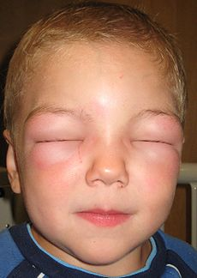
Can’t open eyes due to angioedema

Slide 126
Type 4 - Cell-mediated (Delayed-Type Hypersensitivity, DTH)
Type 4 hypersensitivity reactions are often called delayed type as the reaction takes two to three days to develop. Unlike the other types, it is not antibody mediated but rather is a type of cell-mediated response.
CD8+ cytotoxic T cells and CD4+ helper T cells recognise antigen in a complex with either type 1 or type 2 major histocompatibility complex. The antigen-presenting cells in this case are macrophages which secrete IL-1, which stimulates the proliferation of further CD4+ T cells

Slide 127
CD4+ T cells secrete IL-2 and interferon gamma, further inducing the release of other cytokines, thus mediating the immune response.
MHC 1 or MHC 2+ANTIGEN> RECOGNITION BY CD4+ or CD8+ HELPER T CELLS> macrophages release IL-1 > proliferation of further CD4+ > release of IL-2 & interferon gamma > dealed immune response is produced

Slide 128
UNIT # IV
CLINICAL & SURGICAL ASEPSIS

Slide 129
SIX STEPS OF CHAIN OF INFECTION
Elements in the cycle of infection.
1. Infectious Agent
  When germs enter the body, they can cause illness.
  Eg. Bacteria, virus, fungi, protozoa, helminths.
2. Reservoir
  Where germs normally live and multiply in
  Eg Humans, Contaminated food, water, toys, sports equipment, Insects, animals, soil etc.
3. Portal of Exit
  How germs leave the body
  Eg Respiratory tract, Intestinal tract, Urinary/genitourinary tract, Open wounds, Blood and body fluids.

Slide 130
SIX STEPS OF CHAIN OF INFECTION
4. Transmission
How germs are spread
  Direct physical contact
  Respiratory droplet
  Stool (fecal-oral route)
  Contact with blood/body fluids
  Indirect contact
  Needle stick injury
  Ingestion of contaminated food and water
  Contaminated dust particles
  Contaminated objects
  Insects/animals

Slide 131
SIX STEPS OF CHAIN OF INFECTION
5. Portal of Entry.
How germs enter the body
  Respiratory tract
  Intestinal tract
  Urinary/genitourinary tract
  Open wounds
  Mucus membrane, e.g. eye, mouth
6. Susceptible Host
  A person who gets an infection because he/she is unable to successfully fight the infection Infants, elderly and debilitated.
  Persons who are ill.
  Children who are not fully immunized or have underdeveloped immune systems.
  Persons taking certain drugs that lower their defenses against germs.
  Persons with underlying disease conditions that lower their defense against other germs.

Slide 132
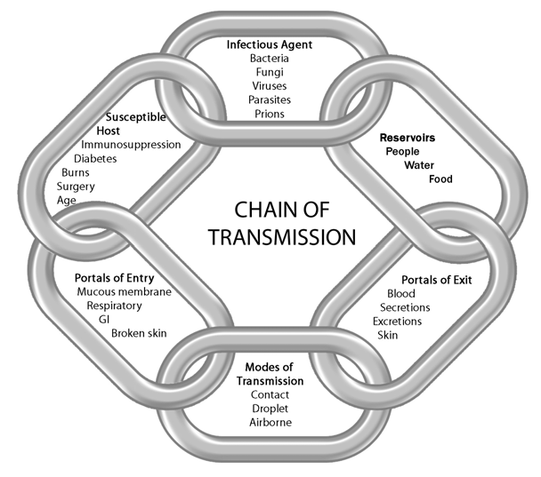

Slide 133
Ways via which infections spread
Infectious diseases can spread in a variety of ways:
through the air,
from direct or indirect contact with another person,
soiled objects,
skin or mucous membrane,
saliva, urine, blood and body secretions,
through sexual contact,
and through contaminated food and water.

Slide 134
Airborne droplets from the nose and throat
Some infections are spread when an infected person sneezes or coughs out tiny airborne droplets. The droplets in the air may be breathed in directly by another person or indirectly enter another person through contact with surfaces and hands with the droplets on them.
Examples of airborne diseases:
Chickenpox
Common cold
Diphtheria
Influenza
Measles
Meningitis (bacterial)
Mumps
Pneumococcal pneumonia
Tuberculosis (TB)
Whooping cough

Slide 135
Urine
Some infections are spread when urine is transferred from soiled hands or objects to the mouth.
Example of a disease spread by urine:
Cytomegalovirus infection (CMV).(any of a group of herpes viruses that enlarge epithelial cells and can cause birth defects).

Slide 136
Faecal-oral
Some infections are spread when microscopic amounts of faeces from an infected person with symptoms or an infected person without symptoms (a carrier) are taken in by another person by mouth. The faeces may be passed directly from soiled hands to the mouth or indirectly by way of objects, surfaces, food or water soiled with faeces.
Examples of diseases spread from faeces:
Giardiasis
Hepatitis A
Meningitis (viral)
Salmonella infection
Thrush
Viral gastroenteritis
Worms

Slide 137
Blood/body fluids
Some infections are spread when blood or other body fluids from an infected person comes into contact with the mucous membranes or bloodstream of an uninfected person, such as through a needle stick or a break in the skin.
Examples of diseases spread through blood/body secretions:
Hepatitis B
Hepatitis C
Human immunodeficiency virus (HIV/AIDS)
Cytomegalovirus (CMV) infection.

Slide 138
Skin or mucous membrane (lining of nose and mouth) contact
Some infections are spread directly when skin or mucous membrane comes into contact with other skin or mucous membrane. Infections are spread indirectly when skin or mucous membrane comes in contact with contaminated objects or surfaces.
Examples of diseases spread by skin or mucous membrane contact:
Chicken pox
Cold sores (herpes simplex)
Conjunctivitis
Hand, foot and mouth disease
Head lice
Ringworm
Scabies
School sores (impetigo)
Warts.

Slide 139
Sexually transmitted infections
These infections are most commonly transmitted by sexual contact. Sexual contact means genital to genital.
Examples of sexually transmitted diseases:
Genital herpes
Genital warts
Gonorrhoea (symptoms are painful urination and pain around the urethra )
Hepatitis B
HIV/AIDS
Non specific urethritis (NSU)
Pubic lice (crabs)
Syphilis

Slide 140
Food or waterborne diseases
These diseases result from ingestion of water or a wide variety of foods contaminated with disease-causing micro-organisms or their toxins. Often these infections are also spread by the faecal-oral route.
Examples of food or waterborne diseases:
Cholera
Giardiasis
Salmonella infection
Typhoid

Slide 141
Saliva
Some infections are spread by direct contact with saliva (such as kissing) or indirect contact with contaminated objects (such as children sucking and sharing toys).
Examples of diseases spread by saliva:
Cytomegalovirus (CMV) infection
Glandular fever(an acute disease characterized by fever and swollen lymph nodes).
Hepatitis B.

Slide 142
Diseases where person-to-person spread occurs rarely
Some infectious diseases are almost without exception never spread by direct contact with an infected person. These diseases are usually spread by contact with an environmental source such as animals, insects, water or soil.
Examples of diseases spread by contact with animals:
Cat-scratch disease
Rabies
Dengue fever
Malaria

Slide 143
Examples of diseases spread by contact with water or soil:
Amoebic meningitis
Tetanus.

Slide 144
Hospital-acquired infections or HAI
Risk of infection is defined as "the state in which an individual is at risk to be invaded by an pathogenic agent.
Infections of the lungs, wounds, urinary tract and bloodstream can occur in hospital.
These are called hospital-acquired infections or HAI. There are things you can do before and during your stay in hospital that will help reduce the chance of getting sick during your stay. They are also known as nosocomial infections.

Slide 145
Hospital infections
An infection is a disease caused by micro-organisms like viruses, fungi, bacteria or parasites. These micro-organisms are often called ‘bugs’ or ‘germs’. Bacteria are the most common cause of HAI.
HAI usually occurs two to three days after admission to hospital. These infections cause:
Longer stay in hospital
Longer recovery time
Costs associated with a longer stay in hospital and longer recovery time.

Slide 146
Some people are more susceptible
All patients admitted to hospital are at some risk of contracting an HAI. If you are very sick or have had surgery, you have an increased risk. Some patients are more vulnerable than others. These include:
Very young people - premature babies and very sick children
Very old people - the elderly
Those with medical conditions - such as diabetes
People with defective immunity - people with diseases that compromise their immune system or people who are being treated with chemotherapy or steroids

Slide 147
Other risk factors
There are other risk factors that may increase your likelihood of acquiring HAI. These include:
Length of stay - a long hospital stay can increase the risk: for example, admission for complex or multiple illnesses.
Operations and surgical procedures - the length and type of surgery can also impact.
Hand washing techniques - inadequate hand washing by hospital staff and patients may increase your risk.
Antibiotics - overuse of antibiotics can lead to resistant bacteria, which means that antibiotics become less effective.
Equipment - invasive procedures can introduce infection into the body: for example, procedures that require the use of equipment such as urinary catheters, IV drips and infusions, respiratory equipment and drain tubes.
Wounds - wounds, incisions (surgical cuts), burns and ulcers are all prone to infection.
High-risk areas - some areas of the hospital are more likely to have infection, such as intensive care units (ICU) and high dependency units (HDU).

Slide 148
Types of infections
The most common types of infection acquired in hospitals are:
Urinary tract infections (UTI)
Wound infection
Pneumonia (lung infection)
Bloodstream infection.
Infections are treated with antibiotics and usually respond well. Occasionally, infections can be serious and life threatening. Some bacteria are hard to treat because they are resistant to standard antibiotics. These bacteria are sometimes called ‘superbugs’.

Slide 149
Controlling infection
Spread of infection can be controlled and reduced by:
Strict hospital infection control procedures and policies
Correct and frequent hand washing by all hospital staff and patients
Cautious use of antibiotic medication.
How to reduce your risk
If you are going to hospital, there are things you can do before admission and in hospital that will help reduce the chance of you getting an infection.

Slide 150
Before admission
Follow these steps before you go to hospital:
Stop smoking - smoking can interfere with healing processes. It also damages the airways, which can make lung infections more likely.
Maintain a healthy weight - people who are overweight are more prone to infection.
Inform your doctor of all existing or recent illness - a cold or the flu can lead to a chest infection, so let your doctor or the hospital staff know if you are not well.
Manage diabetes - if you are a diabetic, make sure that your blood sugar levels are under control.

Slide 151
During your stay
Some things that can help reduce the chance of infection while you are in hospital include:
Make sure that you wash your hands properly, especially after using the toilet. Remind hospital staff to do the same before and after they attend to you.
Let your nurse know if the site around the needle is not clean and dry if you have an IV drip.
Tell your nurse if the dressings are not clean, dry and attached around any wounds you may have.
Let your nurse know if tubes or catheters feel displaced.
Do your deep breathing exercises - the staff will instruct you. This is very important because they can help prevent a chest infection.
Ask relatives or friends who have colds or are unwell not to visit.

Slide 152
What to expect if you get an infection
If you do acquire an infection in hospital, other procedures and practices (apart from antibiotic treatment) may be put in place to stop the spread of infection to other patients. Depending on the type of infection, these might include:
Isolation in a single room
Being put last on the operation surgery list
Being nursed by staff wearing gloves and gowns

Slide 153
UNIT # V
CONCEPT OF ISOLATION

Slide 154
ISOLATION
Definition
  Isolation refers to the precautions that are taken in the hospital to prevent the spread of an infectious agent from an infected or colonized patient to susceptible persons.
Purpose
  Isolation practices are designed to minimize the transmission of infection in the hospital, using current understanding of the way infections can transmit. Isolation should be done in a user friendly, well-accepted, inexpensive way that interferes as little as possible with patient care, minimizes patient discomfort, and avoids unnecessary use.

Slide 155
EXPLANATION
In health care, isolation refers to various measures taken to prevent contagious diseases from being spread from a patient to other patients, health care workers, and visitors, or from others to a particular patient. Various forms of isolation exist, some of which contact procedures are modified, and others in which the patient is kept away from all others.
Isolation is most commonly used when a patient has a viral illness. Special equipment is used in the treatment of patients on the various forms of isolation. These most commonly include gowns, masks, and gloves.

Slide 156
TYPES OF ISOLATION
Strict isolation
Strict isolation is used for diseases spread through the air and in some cases by contact. Patients must be placed in isolation to prevent the spread of infectious diseases. Those who are kept in strict isolation are often kept in a special room at the facility designed for that purpose. Such rooms are equipped with a special lavatory and care giving equipment, and a sink and waste disposal are provided for workers upon leaving the area.
Contact isolation
Contact isolation is used to prevent the spread of diseases that can be spread through contact with open wounds. Health care workers making contact with a patient on contact isolation are required to wear gloves, and in some cases, a gown.

Slide 157
TYPES OF ISOLATION
Respiratory isolation
Respiratory isolation is used for diseases that are spread through particles that are exhaled. Those having contact with or exposure to such a patient are required to wear a mask.
Blood and body fluids precautions
This method is used when there is concern about communicable diseases found in a patient's body fluid. Health care workers making contact with the patient when body fluids are involved must wear gloves.
Reverse isolation
Reverse isolation is a method to prevent a patient in a compromised health situation from being contaminated by other people or objects.

Slide 158
Nurse responsibilites
Frequent hand washing
Keeping working area clean and neat
Keeping working equipments microbes free
Using various types of barriers eg gloves, gowens, masks etc
Avoid unnecessary visits of patients
Avoid overcrowding at nursing units and wards

Slide 159
Unit # VI
HUMAN AND MICROBIAL INTERACTION

Slide 160
The Normal Flora
In a healthy animal, the internal tissues, e.g. blood, brain, muscle, etc., are normally free of microorganisms. However, the surface tissues, i.e., skin and mucous membranes, are constantly in contact with environmental organisms and become readily colonized by various microbial species. The mixture of organisms regularly found at any anatomical site is referred to as the normal flora, by researchers in the field who prefer the term "indigenous microbiota". The normal flora of humans consists of a few eucaryotic fungi and protists, but bacteria are the most numerous and obvious microbial components of the normal flora.

Slide 161
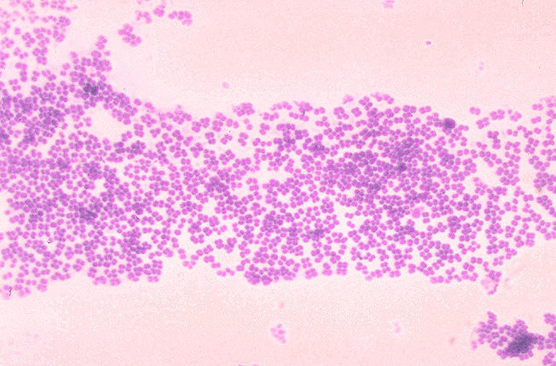
Figure
Gram stain of a species of Micrococcus, commonly isolated from the skin and nasal membranes of humans

Slide 162
Types of flora
Transient flora
Transient means they are not always present in the body- like those that cause illness.
Transient bacteria live on the surface of skin and can be easily killed with proper hand washing. Soap and water or an antiseptic often kills transient bacteria.
Resident flora
Resident means they are a natural part of the body makeup- like normal intestinal flora.
Resident bacteria can be found in deeper layers of the skin and are harder to remove. Washing your hands with soap and water or an antiseptic may kill some resident bacteria but not all.

Slide 163
Beneficial roles of normal flora
Normal flora is defined as a mixture of organisms regularly found at any anatomical site.
The human body contains more than 400 species of bacteria.
Normal flora have beneficial effects on the host that include preventing growth and colonization of harmful pathogens and anti-inflammatory effects.

Slide 164
1. The normal flora synthesize and excrete vitamins in excess of their own needs, which can be absorbed as nutrients by their host. For example, in humans, enteric bacteria secrete Vitamin K and Vitamin B12, and lactic acid bacteria produce certain B-vitamins. Germ-free animals may be deficient in Vitamin K to the extent that it is necessary to supplement their diets.
2. The normal flora prevent colonization by pathogens by competing for attachment sites or for essential nutrients. This is thought to be their most important beneficial effect, which has been demonstrated in the oral cavity, the intestine, the skin, and the vaginal epithelium. In some experiments, germ-free animals can be infected by Salmonella bacteria, while these infections for conventional animals are very rear.

Slide 165
3. The normal flora may antagonize other bacteria through the production of substances which inhibit or kill non indigenous species. The intestinal bacteria produce a variety of substances ranging from relatively nonspecific fatty acids and peroxides to highly specific bacteriocins, which inhibit or kill other bacteria.
4. The normal flora stimulate the development of certain tissues, i.e., the caecum and certain lymphatic tissues in the GI tract. The caecum of germ-free animals is thin-walled, compared to that organ in conventional animals. Also, based on the ability to undergo immunological stimulation, the intestinal lymphatic tissues of germ-free animals are poorly-developed compared to conventional animals.

Slide 166
5. The normal flora stimulate the production of natural antibodies.
Since the normal flora behave as antigens in an animal, they induce an immunological response, in particular, an antibody-mediated immune (AMI) response. Low levels of antibodies produced against components of the normal flora are known to cross react with certain related pathogens, and thereby prevent infection or invasion. Antibodies produced against antigenic components of the normal flora are sometimes referred to as "natural" antibodies, and such antibodies are lacking in germ-free animals.

Slide 167
Nosocomial infections
  Infection acquired during stay at hospital are known as Nosocomial infections.
  They are also known as HAI.
  The HAI or nosocomial infections can be avoided by carrying out various preventive or safety measures.

Slide 168
Prevention of nosocomial infection
Reducing person-to-person transmission
Hand decontamination
Personal hygiene
Clothing
Masks
Gloves
Safe injection practices
Preventing transmission from the environment
Cleaning of the hospital environment
Use of hot/superheated water
Disinfection of patient equipment
Sterilization

Slide 169
DISEASES
Dr. Ajab Khan Yousafzai (Pharm.D)

Slide 170
Tetanus
Tetanus is a serious bacterial disease that affects your nervous system, leading to painful muscle contractions, particularly of your jaw and neck muscles.
Tetanus can interfere with your ability to breathe and, ultimately, threaten your life.
The incidence of tetanus is much higher in less developed countries. Around a million cases occur worldwide each year.
There's no cure for tetanus. Treatment focuses on managing complications until the effects of the tetanus toxin resolve. Fatality is highest in individuals who haven't been immunized and in older adults with inadequate immunization.

Slide 171
Tetanus is caused by a type of bacteria (Clostridium tetani).
The tetanus bacteria often enter the body through a puncture wound, which can be caused by nails, splinters, insect bites, burns, any skin break, and injection-drug sites.
All children and adults should be immunized against tetanus by receiving vaccinations.
A tetanus booster is needed every 10 years after primary immunization or after a puncture or other skin wound which could provide the tetanus bacteria an opportunity to enter the body.

Slide 172
Tetanus, sometimes called lockjaw. A toxin produced by the bacteria affects the function of the nerves and leads to severe muscle spasmsin the abdomen, neck, stomach, and extremities.
Tetanus can either be localized to one part of the body or generalized, with muscle spasms throughout the body. The disease has been called lockjaw since the muscle spasms in the face and neck can lead to the inability to open the mouth, and this is one of the most common symptoms of tetanus. Tetanus is a serious illness that is fatal in up to 30% of cases.

Slide 173
The bacteria that cause tetanus can be found in soil, manure, or dust.
They infect humans by entering the body through cuts or puncture wounds, particularly when the wound area is dirty. Animal bites, burns, and non-sterile injection of drugs can also lead to infection with Clostridium tetani.
The first symptoms of tetanus can appear any time from three days to weeks after infection, but the average time until symptom onset is eight days.
Tetanus is not contagious, so you cannot acquire the disease from someone who has it.

Slide 174
Causes of Tetanus
Clostridium tetani
Clostridia are anaerobic bacteria, meaning they thrive best in the absence of oxygen.
They're commonly found in soil, but can also be found in the lower intestines of mammals.
They can produce spores that can survive for years.

Slide 175
Symptoms of Tetanus
Symptoms may appear anywhere from 2 days to 6 weeks after the wound has been infected, but the typical incubation period (time between infection and symptoms) is 5 to 10 days. Symptoms can be mild or severe and include:
chills
difficulty swallowing
headache
irritability
jaw and neck stiffness
low fever
restlessness
sore throat
stiff arms and legs

Slide 176
Treating and Preventing Tetanus
People with tetanus need to be in an intensive care unit so they can receive treatment and continuous monitoring.
Treatment of tetanus usually includes:
supportive care
medications to control muscle spasms
antibiotics and tetanus immune globulin to manage the infection
wound treatment
vaccination

Slide 177
Typhoid
Thus us a commonly occurring bacterial disease caused by a bacterium Salmonella typhi .
The bacterium Salmonella typhi is present only in human beings and is transmitted through contaminated food or water.
People with this infection carry the bacterium in their intestines and bloodstream, and those who have recovered from the disease could still have the bacterium in their system; they are known as ‘carriers’ of the disease.
Both ill people and carriers shed Salmonella typhi in their stool. Infection is usually spread when food or water is handled by a person who is shedding the bacterium or if sewage water leaks into drinking water or food that is then consumed.
That is why this disease is common in areas where proper hand washing techniques are not followed.

Slide 178
Common Symptoms
Once the bacterium is ingested it quickly multiplies within the stomach, liver or gallbladder and finally enters the blood stream causing symptoms like
  fever (usually between 103⁰F- 104⁰F),
  rashes (flat, rose-coloured spots),
  vomiting,
  loss of appetite,
  headaches,
  general fatigue.
  In severe cases one may suffer from intestinal perforations or internal bleeding, diarrhoea or constipation.

Slide 179
One of the characteristic symptoms of typhoid is a ‘step ladder fever’. This means that the fever gradually fluctuates between very high and low fever for a short period of time, till it peaks at 103⁰F – 104⁰F.
In patients without any complications the condition subsides in about three to four weeks after its onset.
In about 10% of people, the condition relapses after about one week of convalescence.

Slide 180
Diagnosis
Usually diagnosed using a stool sample or blood sample, the presence of the bacterium is most easily visible even at the beginning of the disease.

Slide 181
Treatment
Once diagnosed a patient is treated with antibiotics.
A few years back, patients were treated using chloramphenicol. But after it showed to have severe side effects in some patients.
The drug of choice has been changed to ciprofloxacin and ampicillin amongst others.
Usually depending on the severity of the condition, a patient might be administered the drugs either orally or intravenously.
A new vaccine to fight typhoid.
Typbar-TCV is said to be the world’s first clinically proven typhoid conjugate vaccine which can provide long term protection to adults as well as children six months old and above

Slide 182
Cholera
Cholera is an acute diarrheal infection caused by ingestion of food or water contaminated with the bacterium Vibrio cholerae.
Every year, there are an estimated 3–5 million cholera cases and 100 000–120 000 deaths due to cholera.
The short incubation period of two hours to five days, enhances the potentially explosive pattern of outbreaks.

Slide 183
Vibrio cholerae strains
Two serogroups of V. cholerae – O1 and O139 – cause outbreaks.
V. cholerae O1 causes the majority of outbreaks, while O139 – first identified in Bangladesh in 1992 – is confined to South-East Asia.
Non-O1 and non-O139 V. cholerae can cause mild diarrhoea but do not generate epidemics.
Recently, new variant strains have been detected in several parts of Asia and Africa. Observations suggest that these strains cause more severe cholera with higher case fatality rates.
The main reservoirs of V. cholerae are people and aquatic sources often associated with algal blooms. Recent studies indicate that global warming creates a favorable environment for the bacteria.

Slide 184
Symptoms
Cholera is an extremely virulent disease. It affects both children and adults and can kill within hours.
About 75% of people infected with V. cholera do not develop any symptoms, although the bacteria are present in their feces for 7–14 days after infection and are shed back into the environment, potentially infecting other people.
Among people who develop symptoms, 80% have mild or moderate symptoms, while around 20% develop acute watery diarrhea with severe dehydration. This can lead to death if untreated.
People with low immunity – such as malnourished children or people living with HIV – are at a greater risk of death if infected.

Slide 185
Treatment
Cholera is an easily treatable disease.
Up to 80% of people can be treated successfully through prompt administration of oral rehydration salts (WHO/UNICEF ORS standard sachet).
Very severely dehydrated patients require administration of intravenous fluids. Such patients also require appropriate antibiotics to diminish the duration of diarrhoea, reduce the volume of rehydration fluids needed, and shorten the duration of V. cholera excretion.
Mass administration of antibiotics is not recommended, as it has no effect on the spread of cholera and contributes to increasing antimicrobial resistance.

Slide 186
Diphtheria خناق
Diphtheria is a bacterial infection that affects the membranes of the throat and nose.
Although it spreads easily, diphtheria can be prevented through the use of vaccines.
If left untreated, diphtheria can cause severe damage to your kidneys, nervous system, and heart.

Slide 187
Causes
Diphtheria is caused by the corynebacterium diphtheriae bacterium.
It’s most commonly spread through person-to-person contact or contact with items that have the bacteria on them.
Coming into contact with items such as an infected person’s cup or used tissue can transfer the bacteria.
The mist exhaled by an infected person’s sneeze or cough can also contain the bacteria.
Even if the infected person does not show any signs or symptoms of diphtheria, he or she is still able to transmit the infection for up to six weeks.

Slide 188
Risk factors
Children in the United States are routinely vaccinated against diphtheria. You are usually only at risk if you visit a country that does not provide immunizations or if you’re not up to date on your vaccinations. According to the World Health Organization, India and Indonesia had the highest number of diphtheria incidents in 2011. (WHO)
Before the use of vaccines, children had the highest risk of being infected. Now, people with a weakened immune system—such as those with AIDS—are included in the at-risk group. Unclean living conditions have also been linked to an increased risk of infection.

Slide 189
Signs & Symptoms
Signs of diphtheria often appear two to five days after infection. In some cases, you could be a carrier of C. diphtheriae and have only mild symptoms (that are similar to the common cold) or no symptoms at all. The most common and visible symptom is a thick, gray coating on your throat and tonsils. Other common symptoms include:
difficulty breathing
swollen lymph nodes in the neck
chills
fever
a loud, barking cough
bluish skin
a sore throat
drooling
a general feeling of uneasiness or discomfort

Slide 190
Diagnosis
Your doctor will likely perform a physical exam to check for swollen lymph nodes. He or she will also ask you about your medical history and the symptoms you’ve been having.
Your doctor may believe that you or your child has diphtheria after observing a gray coating in the throat.
A throat culture may be taken to provide a definitive diagnosis.
If your doctor suspects diphtheria of the skin, a sample of the affected tissue may be removed and sent to a lab for testing.

Slide 191
Treatment for Diphtheria
The first step is an antitoxin injection. If you’re allergic to the antitoxin (previous allergic reactions to diphtheria immunizations or any drug preparations containing horse products), inform your doctor and he can give you small doses of the antitoxin and gradually build up to higher amounts.
After the diphtheria antitoxin, your doctor will prescribe antibiotics like erythromycin and penicillin. Antibiotics help clear up the infection. During treatment, your doctor may have you stay in the hospital to avoid passing on your infection. People you might have exposed to the C. diphtheriae bacteria will want to receive a booster vaccine or antibiotics.

Slide 192
Tuberculosis
Tuberculosis (TB) is a disease caused by bacteria called Mycobacterium tuberculosis. The bacteria usually attack the lungs, but they can also damage other parts of the body.
TB spreads through the air when a person with TB of the lungs or throat coughs, sneezes, or talks. If you have been exposed, you should go to your doctor for tests. You are more likely to get TB if you have a weak immune system.

Slide 193
Causes
Tuberculosis (TB) is caused by Mycobacterium tuberculosis, slow-growing bacteria that thrive in areas of the body that are rich in blood and oxygen, such as the lungs.

Slide 194
Risk factors
Have close contact (such as living in the same house) with someone who has active TB, which can be spread to others. Active TB is very contagious.
Health professionals who may care for people with untreated TB.
Live or work in crowded conditions where they can come into contact with people who may have untreated active TB. This includes people who live or work in prisons, nursing homes, military barracks, or homeless shelters.
Have poor access to health care, such as homeless people, migrant farm workers, or people who abuse alcohol or drugs.
Travel to or from regions where untreated TB is common, such as Latin America (countries in Central America, South America, and the Caribbean), Africa, Asia, Eastern Europe, and Russia.

Slide 195
Risk factors
Because the bacteria that cause tuberculosis are transmitted through the air, the disease can be contagious. Infection is most likely to occur if you are exposed to someone with TB on a day-to-day basis, such as by living or working in close quarters with someone who has the active disease. Even then, because the bacteria generally stay latent (inactive) after they invade the body, only a small number of people infected with TB will ever have the active disease.
TB was once a widespread disease. It was virtually wiped out with the help of antibiotics developed in the 1950s, but the disease has resurfaced in potent new forms -- multidrug-resistant TB and extensively drug-resistant TB. Today, these new and dangerous forms of the disease -- resistant to some of the commonly used drug treatments -- have created a public health crisis in many large cities worldwide.

Slide 196
Symptoms
Symptoms of TB may include
A bad cough that lasts 3 weeks or longer
Weight loss
Loss of appetite
Coughing up blood or mucus
Weakness or fatigue
Fever
Night sweats

Slide 197
Diagnosis
Doctors diagnose active tuberculosis(TB) in the lungs (pulmonary TB) by using a medical history and physical exam, and by checking your symptoms (such as an ongoing cough, fatigue, fever, or night sweats).
Sputum culture. Testing mucus from the lungs (sputum culture) is the best way to diagnose active TB. But a sputum culture can take 1 to 8 weeks to provide results.
Chest X-ray A chest X-ray usually is done if you have:
  A positive tuberculin skin test (also called a TB skin test, PPD test, or Mantoux test).
  Symptoms of active TB, such as a persistent cough, fatigue, fever, or night sweat.
  Rapid sputum test. This test can provide results within 24 hours. This test is done only when a person is strongly suspected of having TB.

Slide 198
Treatment
1st & 2nd line anti-TB drugs are available such as
Inh
Rifampin
Ethambutole
Amickacin
Capriomycin etc
The treatment regimen is of various duration
Eg
Six monts
Nine months
Twelve months
Eighteen months

Slide 199
Pertussis
Also called as Whooping cough
Pertussis is a highly contagious bacterial disease that causes uncontrollable, violent coughing. The coughing can make it hard to breathe. A deep "whooping" sound is often heard when the patient tries to take a breath.

Slide 200
Causes
Pertussis, or whooping cough, is an upper respiratory infection caused by the Bordetella pertussis or Bordetella parapertussisbacteria. It is a serious disease that can cause permanent disability in infants, and even death.
When an infected person sneezes or coughs, tiny droplets containing the bacteria move through the air, and the disease is easily spread from person to person.
The infection usually lasts 6 weeks.
Whooping cough can affect people of any age. Before vaccines weren’t widely available, the disease was most common in infants and young children. Now that most children are immunized before entering school, the higher percentage of cases is seen among adolescents and adults.

Slide 201
Symptoms
Initial symptoms, similar to the common cold, usually develop about a week after exposure to the bacteria.
Severe episodes of coughing start about 10 to 12 days later. In children, the coughing often ends with a "whoop" noise. The sound is produced when the patient tries to take a breath.
Coughing spells may lead to vomiting or a short loss of consciousness. Pertussis should always be considered when vomiting occurs with coughing. In infants, choking spells are common.
Other pertussis symptoms include:
Runny nose
Fever (102 °F or lower)
Diarrhea

Slide 202
Diagnosis
The initial diagnosis is usually based on the symptoms. However, when the symptoms are not obvious, pertussis may be difficult to diagnose. In very young infants, the symptoms may be caused by pneumonia instead.
To know for sure, the health care provider may take a sample of mucus from the nasal secretions and send it to a lab, which tests it for pertussis. While this can offer an accurate diagnosis, the test takes some time, and treatment is usually started before the results are ready.
Some patients may have a complete blood count that shows large numbers of lymphocytes.

Slide 203
Treatment
If started early enough, antibiotics such as erythromycin can make the symptoms go away more quickly. Unfortunately, most patients are diagnosed too late, when antibiotics aren't very effective. However, the medicines can help reduce the patient's ability to spread the disease to others.
Infants younger than 18 months need constant supervision because their breathing may temporarily stop during coughing spells. Infants with severe cases should be hospitalized.
An oxygen tent with high humidity may be used.
Fluids may be given through a vein if coughing spells are severe enough to prevent the person from drinking enough fluids.
Sedatives (medicines to make you sleepy) may be prescribed for young children.
Cough mixtures, expectorants, and suppressants are usually not helpful and should NOT be used.

Slide 204
Mumps
Mumps is a viral infection that primarily affects the parotid glands — one of three pairs of saliva-producing (salivary) glands, situated below and in front of your ears. If you or your child contracts mumps, it can cause swelling in one or both parotid glands.
Mumps was common in the United States until mumps vaccination became routine. Since then, the number of cases has dropped dramatically, so your odds of getting mumps are low. Complications of mumps, such as hearing loss, are potentially serious, but rare.
There's no specific treatment for mumps. Mumps outbreaks still occur in the United States, and mumps is still common in many parts of the world, so getting a vaccination to prevent mumps remains important.

Slide 205
Causes
The cause of mumps is the mumps virus, which spreads easily from person to person through infected saliva.
If you're not immunized, you can contract mumps by breathing in saliva droplets of an infected person who has just sneezed or coughed.
You can also contract mumps from sharing utensils or cups with someone who has mumps

Slide 206
Symptoms
Some people infected with the mumps virus have either no signs or symptoms or very mild ones. When signs and symptoms do develop, they usually appear about two to three weeks after exposure to the virus and may include:
Swollen, painful salivary glands on one or both sides of your face (parotitis)
Fever
Headache
Weakness and fatigue
Loss of appetite
Pain while chewing or swallowing
The primary — and best known — sign of mumps is swollen salivary glands that cause the cheeks to puff out. In fact, the term "mumps" is an old expression for lumps or bumps within the cheeks.

Slide 207
Diagnosis
If your doctor suspects that you or your child has mumps, a virus culture or a blood test may be needed.
Your immune system normally makes antibodies to help you fight an infection. So if you have mumps, the blood test can detect the antibodies in your system that are fighting the mumps virus.

Slide 208
Treatment
Because mumps is caused by a virus, antibiotics aren't effective. Like most viral illnesses, a mumps infection must simply run its course. Fortunately, most children and adults recover from an uncomplicated case of mumps within about two weeks.
As a general rule, you're no longer considered contagious and may safely return to work or school one week after a diagnosis of mumps.

Slide 209
Measles چیچک/ خسرہ
Measles is a childhood infection caused by a virus. Once quite common, measles can now be prevented with a vaccine.
Also called rubeola, measles can be serious and even fatal for small children. While death rates have been falling worldwide as more children receive the measles vaccine, the disease still kills several hundred thousand people a year, most under the age of 5.
By 2000, the measles vaccine had practically eliminated measles in the United States. But there has been a recent resurgence of the disease, as more people have chosen not to vaccinate their children.

Slide 210
Causes
Measles is a respiratory disease caused by a virus.
The disease of measles and the virus that causes it share the same name.
The disease is also called rubeola.
Measles virus normally grows in the cells that line the back of the throat and lungs.
The cause of measles is a very contagious virus, which lives in the mucus in the nose and throat of an infected child or adult. That child or adult is contagious from four days before the rash appears to four days after.
When someone with measles coughs, sneezes or talks, infected droplets spray into the air, where other people can inhale them. The infected droplets may also land on a surface, where they remain active and contagious for several hours. You can contract the virus by putting your fingers in your mouth or nose or rubbing your eyes after touching the infected surface.

Slide 211
Symptoms
The symptoms of measles generally begin about 7-14 days after a person is infected, and include:
Measles Rash on Skin of a patient after 3 days of measles infection.
Blotchy rash
Fever
Cough
Runny nose
Red, watery eyes (conjunctivitis)
Feeling run down, achy (malaise)
Tiny white spots with bluish-white centers found inside the mouth (Koplik’s spots)

Slide 212
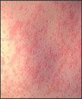
Measles Rash

Slide 213
Diagnosis
Your doctor can usually diagnose measles based on the disease's characteristic rash as well as the small, bright red Koplik's spots on the inside lining of the cheek. If necessary, a blood test can confirm whether the rash is truly measles.

Slide 214
Treatment
No treatment can get rid of an established measles infection. However, some measures can be taken.
Post-exposure vaccination. Nonimmunized people, including infants, may be given the measles vaccination within 72 hours of exposure to the measles virus, to provide protection against the disease. If measles still develops, the illness usually has milder symptoms and lasts for a shorter time.
Immune serum globulin. Pregnant women, infants and people with weakened immune systems who are exposed to the virus may receive an injection of proteins (antibodies) called immune serum globulin. When given within six days of exposure to the virus, these antibodies can prevent measles or make symptoms less severe.

Slide 215
Medications
Fever reducers. You or your child may also take over-the-counter medications such as acetaminophen, ibuprofen or naproxen to help relieve the fever that accompanies measles. Don't give aspirin to children because of the risk of Reye's syndrome — a rare but potentially fatal disease.
Antibiotics. If a bacterial infection, such as pneumonia or an ear infection, develops while you or your child has measles, your doctor may prescribe an antibiotic.
Vitamin A. People with low levels of vitamin A are more likely to have a more severe case of measles. Giving vitamin A may lessen the severity of the measles. It's generally given as a large dose of 200,000 international units (IU) for two days.

Slide 216
Polio
Poliomyelitis (polio) is a highly infectious viral disease, which mainly affects young children. The virus is transmitted through contaminated food and water, and multiplies in the intestine, from where it can invade the nervous system. Many infected people have no symptoms, but do excrete the virus in their faeces, hence transmitting infection to others.
Polio is a contagious viral illness that in its most severe form causes paralysis, difficulty in breathing and sometimes death.
In the U.S., the last case of naturally occurring polio happened in 1979. Today, despite a concerted global eradication campaign, poliovirus continues to affect children and adults in Afghanistan, Pakistan and some African countries.

Slide 217
Causes
The poliovirus resides only in humans and enters the environment in the feces of someone who's infected. Poliovirus spreads primarily through the fecal-oral route, especially in areas where sanitation is inadequate.
Poliovirus can be transmitted through contaminated water and food or through direct contact with someone infected with the virus. Polio is so contagious that anyone living with a recently infected person is likely to become infected, too. People carrying the poliovirus can spread the virus for weeks in their feces.

Slide 218
Symptoms
Although polio can cause paralysis and death, the vast majority of people who are infected with the poliovirus don't become sick and are never aware they've been infected with polio.

Slide 219
Nonparalytic polio
Some people who develop symptoms from the poliovirus contract non paralytic polio — a type of polio that doesn't lead to paralysis. This usually causes the same mild, flu-like signs and symptoms typical of other viral illnesses.
Signs and symptoms, which generally last one to 10 days, include:
Fever
Sore throat
Headache
Vomiting
Fatigue
Back pain or stiffness
Neck pain or stiffness
Pain or stiffness in the arms or legs
Muscle weakness or tenderness
Meningitis

Slide 220
Paralytic polio
In rare cases, poliovirus infection leads to paralytic polio, the most serious form of the disease. Paralytic polio has several types, based on the part of your body that's affected — your spinal cord (spinal polio), your brainstem (bulbar polio) or both (bulbospinal polio).
Initial signs and symptoms of paralytic polio, such as fever and headache, often mimic those of non paralytic polio. Within a week, however, signs and symptoms specific to paralytic polio appear, including:
Loss of reflexes
Severe muscle aches or weakness
Loose and floppy limbs (flaccid paralysis).

Slide 221
Diagnosis
Doctors often recognize polio by symptoms, such as neck and back stiffness, abnormal reflexes, and difficulty in swallowing and breathing. To confirm the diagnosis, a sample of throat secretions, stool or cerebrospinal fluid — a colorless fluid that surrounds your brain and spinal cord — is checked for the presence of poliovirus.

Slide 222
Treatment
Because no cure for polio exists, the focus is on increasing comfort, speeding recovery and preventing complications. Supportive treatments include:
Bed rest
Pain relievers
Portable ventilators to assist breathing
Moderate exercise (physical therapy) to prevent deformity and loss of muscle function.
A nutritious diet.

Slide 223
Influenza
Influenza is a highly contagious disease transmitted by the respiratory route. Its transmission occurs by droplet nuclei.
Epidemics appear at varying intervals, usually in the fall or winter (although cases occur as do in outbreaks in northern areas such as Alaska) affecting 10–20% of the global population on average each year. Antigenic types A and B produce clinically indistinguishable infections, whereas type C is usually a minor illness. Annual influenza epidemics are the result of frequent and significant antigenic variation of the virus, or antigenic drift, which is more common in influenza A virus. Pandemics—associated with higher mortality—typically are associated with type A infections in which significant genetic recombination of the virus (antigenic shift) has taken place. The incubation period is 1–4 days.

Slide 224
Cause
Orthomyxovirus
Also known commonly as influenza virus.
As it is a viral disease ,that’s why it’s very much contagious and can be easily spread via airborne droplets.

Slide 225
Symptoms and Signs
Typical uncomplicated influenza often begins abruptly.
Symptoms include
fever,
chills,
malaise,
myalgias,
headache,
nasal stuffiness,
and occasionally nausea.
Coryza,
nonproductive cough,
and sore throat are present.

Slide 226
Laboratory Findings
Leukopenia is common.
There will be decrease level of wbc in the blood.

Slide 227
Vaccination
Adequate immunity is achieved about 2 weeks after vaccination. In healthy subjects, the antibody level remains sufficiently high throughout the season. Levels wane quickly, however, in elderly nursing home patients. Therefore, the time of administration of the vaccine should be based on surveillance data. The vaccination effectively reduces both morbidity (preventing 35–60% of hospital admissions in the elderly) and mortality (preventing 35–80% of hospital deaths). A new live-attenuated, nasally administered, vaccine is now licensed for use in the United States, while nasally administered inactivated vaccine is under development.

Slide 228
Treatment
Many patients with influenza prefer to rest in bed. Analgesics and a cough mixture may be used. Amantadine or rimantadine, in the same doses are used for prophylaxis, appreciably decrease the duration of symptoms and signs.
Rimantadine is preferred in patients with renal failure. Resistance to amantadine and rimantadine develops in > 50% of children, typically after 3–5 days of exposure, and this resistance is reported in a majority of the influenza isolates from 2005–2006 season.
The clinical significance of resistance to antiviral agents is controversial. Acetaminophen rather than aspirin should be used for fever in children.

Slide 229
Ascariasis
Ascaris lumbricoides is the most common of the intestinal helminths, infecting about a quarter of the world's population, with estimates of over a billion infections, 12 million acute cases, and 10,000 or more deaths annually.
Prevalence is high wherever there is poor hygiene and sanitation or where human feces are used as fertilizer. Heavy infections are most common in children.
Infection follows ingestion of eggs in contaminated food. Larvae hatch in the small intestine, penetrate into the bloodstream, migrate to the lungs, and then travel via airways back to the gastrointestinal tract, where they develop to adult worms, which can be up to 40 cm in length, and live for 1–2 years.

Slide 230
Causes
Ascaris lumbricoides (the giant roundworm of humans).
Infection occurs from ingestion of Ascaris eggs on vegetables and other foods eaten raw that have been contaminated with feces from infected humans.
Infective eggs hatch in the duodenum, penetrate the gut, pass in blood vessels to the lungs, and break out into alveoli, where they molt and in about a week are carried up the bronchioles, bronchi, and trachea to the mouth.
They are then swallowed and return to the small intestine, where the worms mature and survive about 1 year.

Slide 231
Signs & symptoms
Most persons with Ascaris infection are asymptomatic. A small proportion develop symptoms during migration of worms through the lungs, with
fever,
nonproductive cough,
chest pain,
dyspnea,
and eosinophilia,
occasionally with eosinophilic pneumonia.

Slide 232
Clinical Findings
Rarely, larvae lodge ectopically in the brain, kidney, eye, spinal cord, and other sites and may cause local symptoms.
Light intestinal infections usually produce no symptoms. With heavy infection, abdominal discomfort may be seen. Adult worms may also migrate and be coughed up, be vomited, or may emerge through the nose or anus. They may also migrate into the common bile duct, pancreatic duct, appendix, and other sites, which may lead to pancreatitis, obstructive jaundice, or appendicitis.
With very heavy infestations, masses of worms may cause intestinal obstruction or death. Although severe manifestations of infection are uncommon, the very high prevalence of ascariasis leads to large numbers of individuals, especially children.
Moderate to high worm loads in children are also associated with nutritional abnormalities due to decreased appetite and food intake, and also decreased absorption of nutrients.
The diagnosis of ascariasis is made after adult worms emerge from the mouth, nose, or anus, or by identifying characteristic eggs in the feces.
Eosinophilia is marked during worm migration but may be absent during intestinal infection.

Slide 233
Treatment
All infections should ideally be treated. Treatments of choice are albendazole (single 400 mg oral dose), mebendazole (single 500 mg oral dose or 100 mg twice daily for 3 days), or pyrantel pamoate (single 11 mg/kg oral dose, maximum 1 g). These drugs are all well tolerated but may cause mild gastrointestinal toxicity.
They are now considered safe for children above 1 year of age and in pregnancy, although use in the first trimester is best avoided. Intestinal obstruction usually responds to conservative management and antihelminthic therapy. Surgery may be required for appendicitis and other gastrointestinal complications.

